Slide 1

Automation Testing
By- Manas

Slide 2
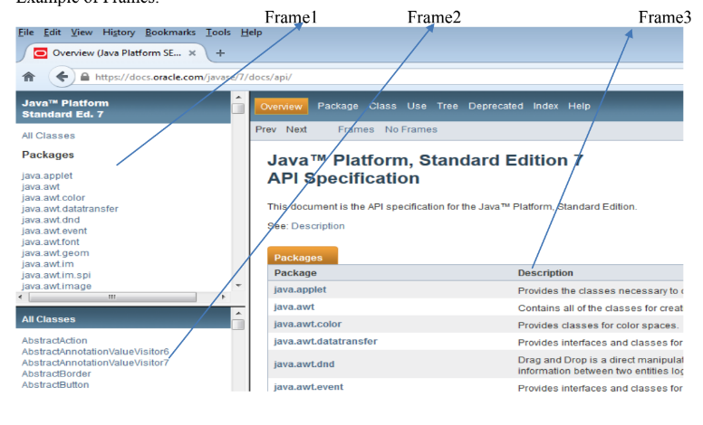
HANDLING FRAMES
We are using this option to handle frames in application using webdriver. For handling frames we need to first switch to frame from driver using “switchTo” method.

Slide 3
What is Frame
HTML frames are used to divide your browser window into multiple sections where each section can load a separate HTML document.
A collection of frames in the browser window is known as a frameset.
The main advantage of frames is that it allows the user to view multiple documents within a single Web page.

Slide 4
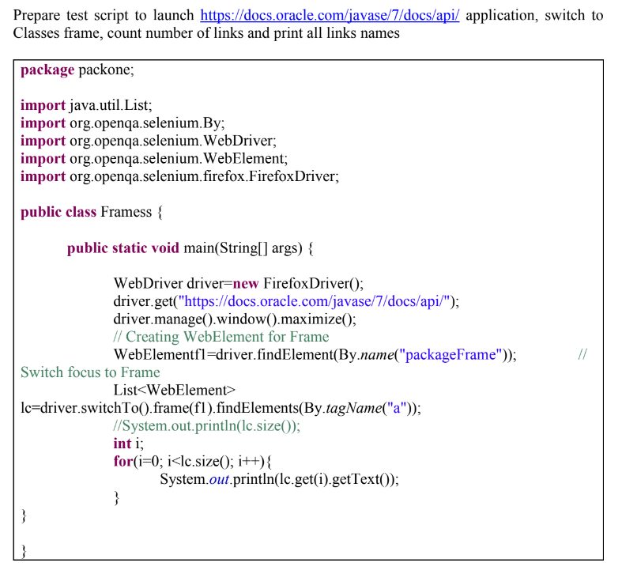

Slide 5
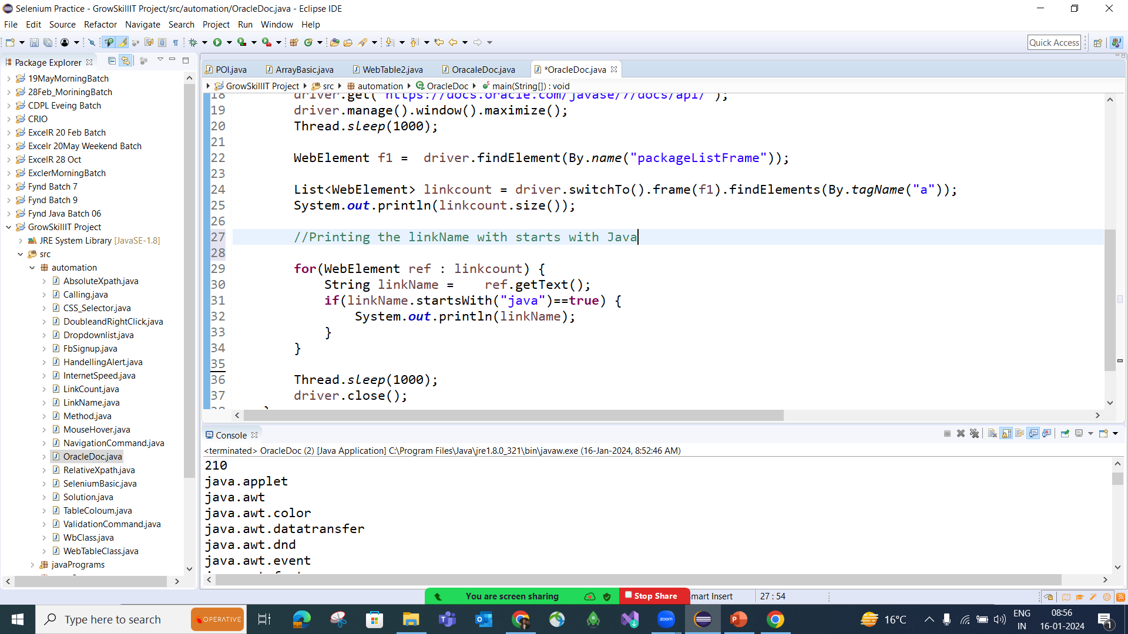

Slide 6
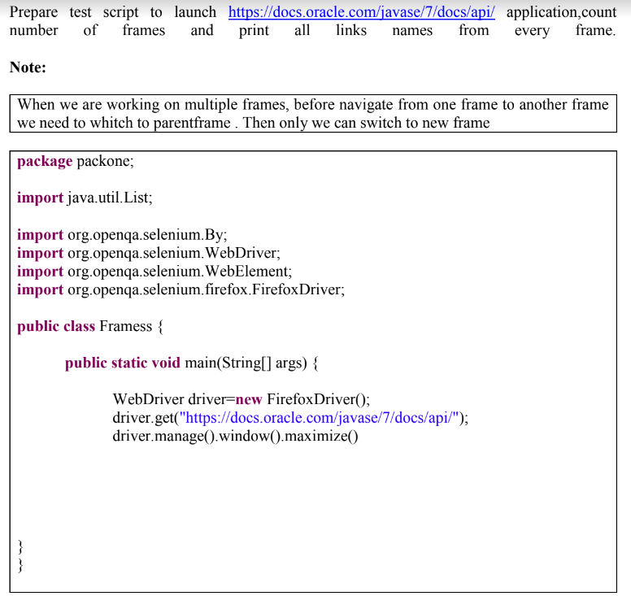
driver.switchTo().parentFrame();
or
driver.switchTo().defaultContent();

Slide 7
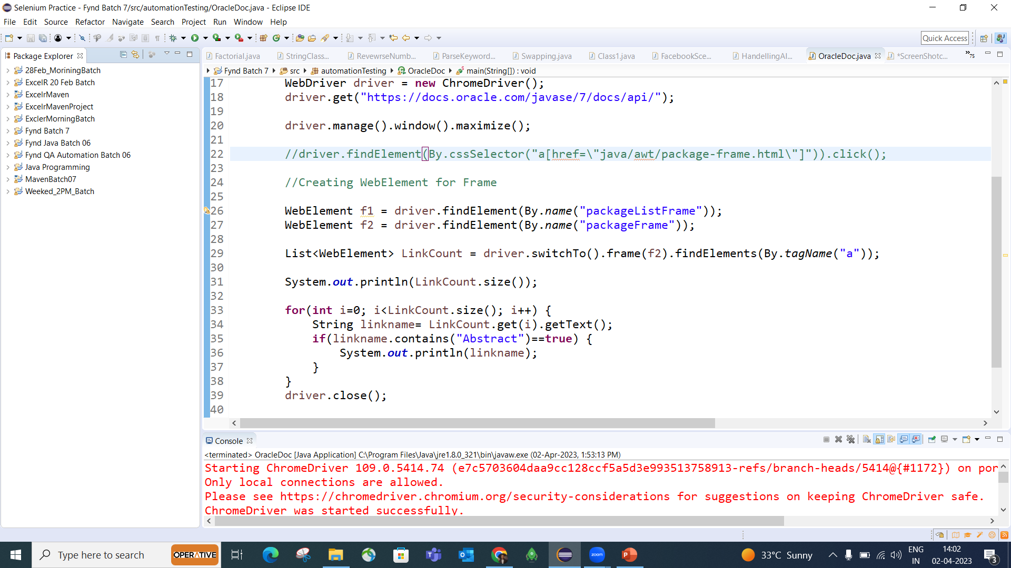

Slide 8
FAQ’s:
What is Frame in Application?
A frame is a webpage inside another webpage. Selenium cannot directly access elements inside a frame; we must switch to that frame first using driver.switchTo().frame().
2. What is the tag name for frame?
frame
3. How to count number of frames in window?
int totalFrames = driver.findElements(By.tagName("frame")).size();
System.out.println(totalFrames);
4. How to switch from one frame to another frame?

